Slide 1

Unit 1: Introduction to Accounting

Slide 2
Content
Need for
accounting concepts
and types of accounts. and
Accounting Accounting Preparation
Conventions, GAAP,
Standards,
Accounting
Equations, accounts,
of Journal & Ledger
Preparation of Trial Balance, Rectification of Errors and Types of Errors.

Slide 7
Introduction
Profit to a business is like food to human body.
Accounting is commonly referred to as the “language of the business” as it is effectively employed to communicate the financial performance of business to various interested parties.
It is concerned with the measurement and communicating financial data.

Slide 8
Need for Accounting
The basic aim of accounting in a business entity is to provide financial information for making decisions on its activities.
This information can be provided only when business transactions are recorded, classified and summarized properly.
Business transactions are numerous, that it is not possible to recall his memory as to how the money had been earned and spent.
In all activities and in all organisations which require money and other economic resources, acounting is required to account for it.

Slide 9
Accountancy
Accountancy refers to a systematic knowledge of accounting.
It explains “why to do” and “how to do” of various aspects of accounting. It tells us why and how to prepare the books of accounts and how to summarize the accounting information and communicate it to the interested parties.

Slide 10
Accounting
The process of identifying, measuring and communicating economic information to permit informed judgements and decisions by users of the information. (American Accounting Association).
The art of recording, classifying and summarising, in a significant manner and in terms of money, transactions and events which are, in part at least, of a financial character and interpreting the results thereof. (The American Institute of Certified Public Accountants)

Slide 11
Book Keeping
R.N. Carter says, “Book-keeping is the science and art of correctly recording in the books of account all those business transactions that result in the transfer of money or money’s worth”.
J. R. Batliboi is “Book-keeping is an art of recording business transactions in a set of books.”

Slide 12
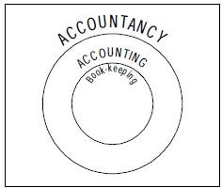
Relationship between Accountancy, Accounting and Book-Keeping
Book-keeping provides the basis for accounting and it is complementary to accounting process.
Accounting begins where book-keeping ends. Accountancy includes accounting and book-keeping.
This relationship can be easily un help of the following diagram.
derstood with the

Slide 13
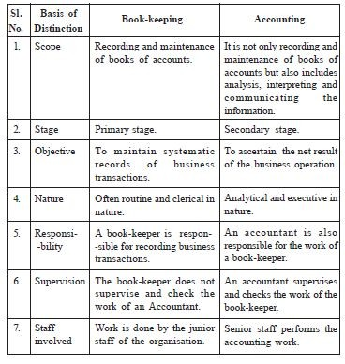
Difference between Book-Keeping and Accounting

Slide 14
Objectives of Accounting
Maintenance of records of Business Transactions.
Calculation of Profit and Loss.
Depiction of financial position.
Providing accounting information to users.
To facilitate proper management of cash.

Slide 15
Features of Accounting or Process of Accounting
Identifying.
Measuring.
Recording.
Classifying.
Summarising.
Analysing and Interpreting.
Communicating.

Slide 16
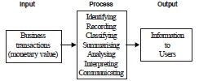
Features of Accounting or Process of Accounting

Slide 17
Accounting Cycle
Accounting Cycle is a series of accounting process which begins with the identification of an economic activity or transaction, recording of the economic activity and ends with the preparation of the financial statements.

Slide 18
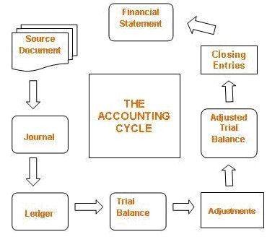
Accounting Cycle

Slide 19
Importance of Accounting
Facilitates to comply with legal requirements.
It shows the mode of investment for shareholders.
It provides business trade credit for suppliers.
It notifies the risks of loan in business for banks and lenders.
Facilitates to replace memory.
Facilitates to ascertain net result of operations.
Facilitates to ascertain financial position.
Facilitates the users to take decisions.
Facilitates a comparative study.

Slide 20
Importance of Accounting
Assists the management in planning and controlling business activities and in taking decisions.
Facilitates control over assets.
Facilitates the settlement of tax liability.
Facilitates the ascertainment of value of business.
Facilitates raising of loans.
Acts as legal evidence.

Slide 21
Scope of Accounting
As accounting derives its usefulness from the social value of the environment in which it is developed, its scope and deﬁnition change with the passage of time.
In general, it is argued that accounting is concerned with the provision of information about the ﬁnancial position, performance and changes in ﬁnancial position of an enterprise that is useful to a wide range of potential users in making economic decisions.

Slide 22
Scope of Accounting
The apparently divergent needs of internal and external users of accounting information have resulted in the development of sub-disciplines within the accounting discipline namely,
Financial Accounting: It is concerned with recording of business transactions in the books of accounts in such a way that operating result of a particular period and financial position on a particular date can be known.
Cost Accounting: It relates to collection, classification and ascertainment of the cost of production or job undertaken by the firm.
●

Slide 23
Scope of Accounting
Management Accounting: It relates to the use of accounting data collected with the help of financial accounting and cost accounting for the purpose of policy formulation, planning, control and decision making by the management.
Social Responsibility accounting: It is the accounting for social responsibility aspects of a business. Management is held responsible for what it contributes to the social well being and progress.

Slide 24
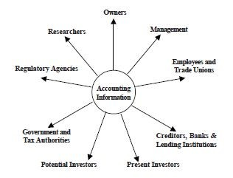
Users of Accounting Information

Slide 25
Basic Accounting Terminologies
Transactions: Transactions are those activities of a business, which involve transfer of money or goods or services between two persons or two accounts. For example, purchase of goods, sale of goods, etc. Transactions are of two types, namely, cash and credit transactions.
Proprietor: A person who owns a business is called its proprietor.
Capital: It is the amount invested by the proprietor/s in the business. For example, if Mr.Anand starts business with Rs.5,00,000, his capital would be Rs.5,00,000.

Slide 26
Basic Accounting Terminologies
Assets: Any physical thing or right owned that has a money value is an asset. In other words, an asset is that expenditure which results in acquiring of some property or benefits of a lasting nature. For Example, Cash in hand, plant and machinery, furniture and fittings, bank balance, debtors, Goodwill, patents, etc.
Liabilities: Liabilities refer to the financial obligations of a business. These denote the amounts which a business owes to others, e.g., loans from banks or other persons, creditors for goods supplied, etc.
Drawings: It is the amount of cash or value of goods withdrawn from the business by the proprietor for his personal use.

Slide 27
Basic Accounting Terminologies
Debtors: A person (individual or firm) who receives a benefit without giving money or money’s worth immediately, but liable to pay in future or in due course of time is a debtor. For example, Mr.Arul bought goods on credit from Mr.Babu for Rs.10,000. Mr.Arul is a debtor to Mr.Babu till he pays the value of the goods.
Creditors: A person who gives a benefit without receiving money or money’s worth immediately but to claim in future, is a creditor. The creditors are shown as a liability in the balance sheet. In the above example Mr.Babu is a creditor to Mr.Arul till he receive the value of the goods.

Slide 28
Basic Accounting Terminologies
Purchases: Purchases refers to the amount of goods bought by a business for resale or for use in the production. Goods purchased for cash are called cash purchases. If it is purchased on credit, it is called as credit purchases.
Purchases Return or Returns Outward: When goods are returned to the suppliers due to defective quality or not as per the terms of purchase, it is called as purchases return.

Slide 29
Basic Accounting Terminologies
Sales: Sales refers to the amount of goods sold that are already bought or manufactured by the business. When goods are sold for cash, they are cash sales but if goods are sold and payment is not received at the time of sale, it is credit sales.
Sales Return or Returns Inward: When goods are returned from the customers due to defective quality or not as per the terms of sale, it is called sales return or returns inward.

Slide 30
Basic Accounting Terminologies
Stock: Stock includes goods unsold on a particular date.
Revenue: Revenue means the amount receivable or realized from sale of goods and earnings from interest, dividend, commission, etc.
Expense: The terms ‘expense’ refers to the amount incurred in the process of earning revenue. If the benefit of an expenditure is limited to one year, it is treated as an
expense (also know is as revenue expenditure) such as payment of salaries and rent..
Income/Profit: Income is the difference between revenue and expense.

Slide 31
Basic Accounting Terminologies
Expenditure: Expenditure takes place when an asset or service is acquired.
The expenditure might be for a significant long term asset (capital expenditure), a short term asset (prepaid insurance), a reduction in a liability, or for an immediate expense such as rent (Revenue Expenditure).

Slide 32
Basic Accounting Terminologies
Voucher: It is a written document in support of a transaction. It may be in the form of cash receipt, invoice, cash memo, bank pay-in-slip etc.
Invoice: Invoice is a business document which is prepared when one sell goods to another. The statement is prepared by the seller of goods.
Receipt: Receipt is an acknowledgement for cash received. It is issued to the party paying cash.
Account: An account is a brief history of financial transactions of a particular person or item. An account has two sides called debit side and credit side.

Slide 33
Basis of Accounting
Transactions are recorded either of the two basis.:
Cash Basis (or)
Accrual Basis
Cash Basis: Under this method, income is not counted until cash (or a cheque) is actually received, and expenses are not counted until they are actually paid.
Accrual Basis: In addition to actual receipts and payments of cash, income receivable and expenses payable are also recorded.

Slide 34
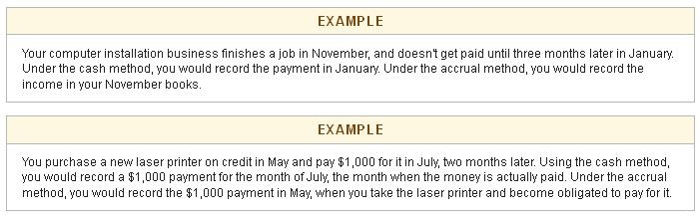
Basis of Accounting

Slide 35
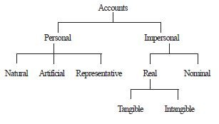
Classification of Accounts

Slide 36
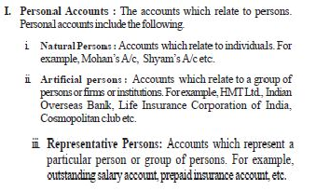
Classification of Accounts

Slide 37
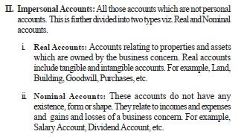
Classification of Accounts

Slide 38
Illustration
1. Capital
3. Drawings
5. Cash
7. Interest paid
2. Sales
4. Outstanding salary
6. Rent
8. Indian Bank
9. Discount received 10. Building
11. Bank 12. Chandrasekhar
13. Murugan Lending Library
14. Advertisement
15. Purchases

Slide 39
Accounting Equation
Accounting equation is based on dual aspect concept (Debit and Credit). It emphasizes on the fact that every transaction has a two sided effect i.e., on the assets and claims on assets.
Always the total claims (those of outsiders and of the proprietors) will be equal to the total assets of the business concern.
The claims are also known as equities, are of two types: i.) Owners equity (Capital); ii.) Outsiders’ equity (Liabilities).

Slide 40
Accounting Equation
Assets = Equities
Assets = Capital + Liabilities (A = C+L)
Capital = Assets – Liabilities (C = A–L)
Liabilities = Assets – Capital (L = A–C).

Slide 41
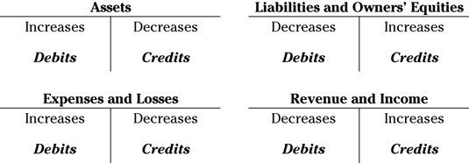
Accounting Equation

Slide 42
Accounting Equation
Illustration 1: If the total assets of a business are Rs.3,60,000 and capital is Rs.2,00,000, calculate liabilities.
Solution
Assets = Capital + Liabilities Liabilities = Assets – Capital Assets – Capital = Liabilities
Rs. 3,60,000 – Rs. 2,00,000 = Rs. 1,60,000

Slide 43
Accounting Equation
Illustration 2:
1) Transaction 1: Murugan started business with Rs.50,000 as capital.
Assets = Capital + Liabilities Cash = Capital + Liabilities
Rs. 50,000 = Rs. 50,000 + 0

Slide 44
Accounting Equation
Transaction 2: Murugan purchased furniture for cash Rs.5,000.
The accounting equation now is as follows: Assets = Capital + Liabilities
Cash + Furniture = Capital + Liabilities Transaction 1 50,000 + 0 = 50,000 + 0
Transaction 2 (–) 5,000 + 5,000 = 0 + 0
Equation 45,000 + 5,000 = 50,000 + 0

Slide 45
Accounting Equation
Transaction 3: He purchased goods for cash Rs.30,000.
Assets = Capital +Liabilities
Cash + Furniture + Stock = Capital +Liabilities (Goods)
Transaction 1&2 45,000 + 5,000 + 0 = 50,000 + 0
Transaction 3 (–) 30,000 + 0 + 30,000 = 0 + 0
Equation 15,000 + 5,000 + 30,000 = 50,000 +
0

Slide 46
Generally Accepted Accounting Principles
The common set of accounting principles, standards and procedures that companies use to compile their financial statements.
GAAP are a combination of authoritative standards (set by policy boards) and simply the commonly accepted ways of recording and reporting accounting information.

Slide 47
Accounting Concepts
Accounting Concepts may be considered as postulates i.e., basic assumptions or conditions upon which the science of accounting is based.
The main objective is to maintain uniformity and consistency in accounting records.

Slide 48
Types of Accounting Concepts
Business Entity
Money Measurement
Going Concern
Cost
Dual Aspect
Accounting Period
Matching
Realisation
Objective Evidence
Accrual

Slide 49
Business Entity Concept
This concept assumes that, for accounting purposes, the business enterprise and its owners are two separate independent entities. Thus, the business and personal transactions of its owner are separate.
For example, when the owner invests money in the business, it is recorded as liability of the business to the owner. Similarly, when the owner takes away from the business cash/goods for his/her personal use, it is not treated as business expense.

Slide 50
Money Measurement Concept
This concept assumes that all business transactions must be in terms of money, that is in the currency of a country. Thus, as per the money measurement concept, transactions which can be expressed in terms of money are recorded in the books of accounts.
For example, sale of goods worth Rs.200000, purchase of raw materials Rs.100000, Rent Paid Rs.10000 etc. are expressed in terms of money, and so they are recorded in the books of accounts.

Slide 51
Going-concern Concept
This concept states that a business firm will continue to carry on its activities for an indefinite period of time. Simply stated, it means that every business entity has continuity of life. Thus, it will not be dissolved in the near future.

Slide 52
Cost Concept
Cost concept states that all assets are recorded in the books of accounts at their purchase price, which includes cost of acquisition, transportation and installation and not at its market price.
For example, a machine was purchased by XYZ Limited for Rs.500000, for manufacturing shoes. An amount of Rs.1,000 were spent on transporting the machine to the factory site. In addition, Rs.2000 were spent on its installation. The total amount at which the machine will be recorded in the books of accounts would be the sum of all these items i.e. Rs.503000.

Slide 53
Dual Aspect Concept
This concept assumes that every transaction has a dual effect,
i.e. it affects two accounts in their respective opposite sides. Therefore, the transaction should be recorded at two places. It means, both the aspects of the transaction must be recorded in the books of accounts.
For example, goods purchased for cash has two aspects which are (i) Giving of cash (ii) Receiving of goods. These two aspects are to be recorded.
Thus, the duality concept is commonly expressed in terms of fundamental accounting equation :
Assets = Liabilities + Capital
The above accounting equation states that the assets of a business are always equal to the claims of owner/owners and the outsiders.

Slide 54
Accounting Period Concept
All the transactions are recorded in the books of accounts on the assumption that profits on these transactions are to be ascertained for a specified period. This is known as accounting period concept.
Thus, this concept requires that a balance sheet and profit and loss account should be prepared at regular intervals.

Slide 55
Matching Concept
Though the business is a continuous affair, its continuity is artificially split into several accounting years for determining the periodical results. Thus, expenses of a particular period are compared with the revenues of that period to determine the net operational results of that accounting period.
As for example; rent for twelve months whether paid or not is matched against the revenues earned during these twelve months.

Slide 56
Realisation Concept
This concept states that revenue from any business transaction should be included in the accounting records only when it is realised.
The term realisation means creation of legal right to receive money. Selling goods is realisation, receiving order is not.
In other words, revenue is said to have been realised when cash has been received or right to receive cash on the sale of goods or services or both has been created.
In short, the realisation occurs when the goods and services have been sold either for cash or on credit.

Slide 57
Objective Evidence Concept
This concept means that all accounting entries should be evidenced and supported by business documents such as invoices, vouchers, etc.
This concept also implies that the evidences must be completely objective, and must be subject to verification by auditors.

Slide 58
Accrual Concept
The Accrual concept is concerned with the recognition of both revenues and expenses.
The meaning of accrual is something that becomes due especially an amount of money that is yet to be paid or received at the end of the accounting period.
It means that revenues are recognised when they become receivable. Though cash is received or not received and the expenses are recognised when they become payable though cash is paid or not paid.
For example, if the firm received goods costing Rs.20000 on 29th March 2005 but the payment is made on 2nd April 2005 the accrual concept requires that expenses must be recorded for the year ending 31st March 2005 although no payment has been made until 31st March 2005 though the service has been received and the person to whom the payment should have been made is shown as creditor.

Slide 59
Accounting Conventions
The term "accounting conventions" refer to the customs or traditions, which are used as a guide in the preparation of meaningful financial records in the form of the income statement (Profit and Loss Account) and the position statement (Balance Sheet).
Conventions help in comparing accounting data of different business units or of the same unit for different periods. These have been developed over the years.

Slide 60
Types of Accounting Conventions
Convention of consistency.
Convention of full disclosure.
Convention of materiality.
Convention of conservatism.

Slide 61
Convention of Consistency
This convention signifies that the accounting practices and methods should remain the consistent from one accounting year to another.
For instance, when once a particular method of depreciation is adopted for a particular fixed asset, the same method should be followed for that asset year after year.

Slide 62
Convention of Full Disclosure
Convention of full disclosure requires that all material and relevant facts concerning financial statements should be fully disclosed.
Full disclosure means that there should be full, fair and adequate disclosure of accounting information.
Adequate means sufficient set of information to be disclosed.
Fair indicates an equitable treatment of users.
Full refers to complete and detailed presentation of information.
Thus, the convention of full disclosure suggests that every financial statement should fully disclose all relevant information.

Slide 63
Convention of Materiality
The convention of materiality states that, to make financial statements meaningful, only material fact
i.e. important and relevant information should be
supplied to the users of accounting information.
Material fact means the information of which will influence the decision of its user.

Slide 64
Convention of Conservatism
This convention is based on the principle that “Anticipate no profit, but provide for all possible losses”.
The main objective of this convention is to show minimum profit. Profit should not be overstated.
Thus, this convention clearly states that profit should not be recorded until it is realised. But if the business anticipates any loss in the near future, provision should be made in the books of accounts for the same.
For example, while valuing stock in trade, market price or cost price whichever is less is considered.

Slide 65
Accounting Standards
The term standard denotes a discipline, which provides both guidelines and yardsticks for evaluation.
As guidelines, accounting standard provides uniform practices and common techniques of accounting.
The Institute of Chartered Accountant of India (ICAI) constituted the Accounting Standards Board (ASB) in April, 1977 for developing accounting standards. However, the International Accounting Standards Committee (IASC) was set up in 1973, with its headquarter in London (U.K.).
The Accounting Standards Board is entrusted with the responsibility of formulating standards on significant accounting matters keeping in view the international developments, and legal requirements in India.

Slide 66
Accounting Standards
The main function of the ASB is to identify areas in which uniformity in standards is required and to develop draft standards after discussions with representatives of the Government, public sector undertaking, industries and other agencies.
The objective of ASB is to standardize the diverse accounting policies and practices with a view to eliminate to the extent possible the
non-comparability of financial statements and the reliability to the financial statements.

Slide 67
Compliance with Accounting Standards Issued by ICAI
Sub Section(3A) to section 211 of Companies Act, 1956 requires that every Profit/Loss Account and Balance Sheet shall comply with the Accounting Standards. 'Accounting Standards' means the standard of accounting recomended by the ICAI and prescribed by the Central Government in consultation with the National Advisory Committee on Accounting Standards (NACAs) constituted under section 210(1) of companies Act, 1956.

Slide 68
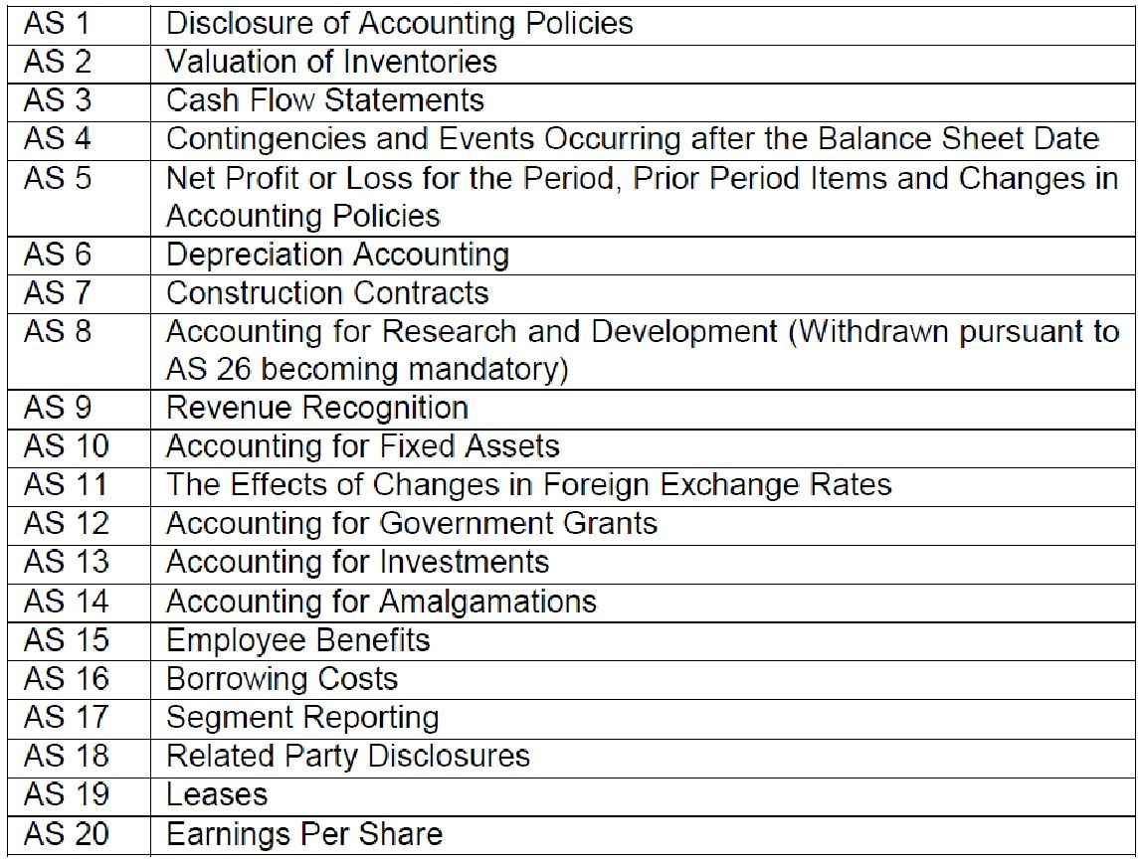
Accounting Standards Issued by ICAI

Slide 69
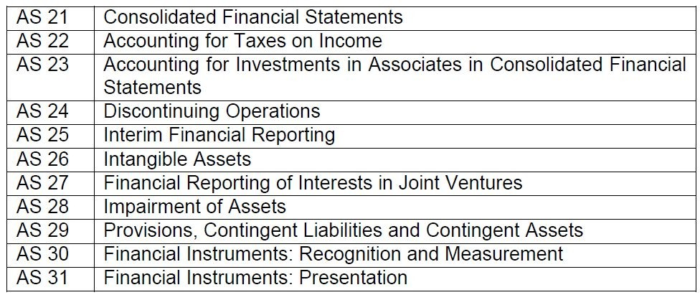
Accounting Standards Issued by ICAI

Slide 70
Accounting Standards (AS) 1 - Disclosure of Accounting Policies
Disclosure of Accounting Policies: Accounting Policies refer to specific accounting principles and the method of applying those principles adopted by the enterprises in preparation and presentation of the financial statements.
This Standard prescribes the basis for presentation of general purpose financial statements to ensure comparability both with the entity’s financial statements of previous periods and with the financial statements of other entities.

Slide 71
Accounting Standard (AS) 2 - Valuation of Inventories
Valuation of Inventories: The objective of this standard is to formulate the method of computation of cost of inventories / stock, determine the value of closing stock / inventory at which the inventory is to be shown in balance sheet till it is not sold and recognized as revenue.

Slide 72
Accounting Standard (AS) 3 - Cash Flow Statements
Cash Flow Statements: Cash flow statement is additional information to user of financial statement. This statement exhibits the flow of incoming and outgoing cash. This statement assesses the ability of the enterprise to generate cash and to utilize the cash. This statement is one of the tools for assessing the liquidity and solvency of the enterprise.
The objective of this Standard is to require the provision of information about the historical changes in cash and cash equivalents of an entity by means of a statement of cash flows which classifies cash flows during the period from operating, investing and financing activities.

Slide 73
Accounting Standard (AS) 4 - Contingencies and Events Occurring after the Balance Sheet Date
Contingencies and
Events occurring
after the
balance sheet date: In preparing financial statement of a particular enterprise, accounting is done by following accrual basis of accounting and prudent accounting policies to calculate the profit or loss for the year and to recognize assets and liabilities in balance sheet.
While following the prudent accounting policies, the provision is made for all known liabilities and losses even for those liabilities / events, which are probable. Professional judgement is required to classify the likehood of the future events occuring and, therefore, the question of contingencies and their accounting arises.

Slide 74
Accounting Standard (AS) - 5 Net Profit or Loss for the Period, Prior Period Items and Changes in AS
Net Profit or Loss for the Period, Prior Period Items and change in Accounting Policies : The objective of this accounting standard is to prescribe the criteria for certain items in the profit and loss account so that comparability of the financial statement can be enhanced. Profit and loss account being a period statement covers the items of the income and expenditure of the particular period.

Slide 75
Accounting Standard (AS) 6 - Depreciation Accounting
Depreciation is a measure of the wearing out, consumption or other loss of value of a depreciable asset arising from use, effluxion of time or obsolescence through technology and market changes.
Different accounting policies for depreciation are adopted by different enterprises. Disclosure of accounting policies for depreciation followed by an enterprise is necessary to appreciate the view presented in the financial statements of the enterprise.

Slide 76
Accounting Standard (AS) 7 - Construction Contracts
Accounting for long term construction contracts involves question as to when revenue should be recognized and how to measure the revenue in the books of contractor.
As the period of construction contract is long, work of construction starts in one year and is completed in another year or after 4-5 years or so. Therefore question arises how the profit or loss of construction contract by contractor should be determined.
There may be following two ways to determine profit or loss: On year-to-year basis based on percentage of completion or On completion of the contract.

Slide 77
Accounting Standard (AS) 8 - Accounting for Research and Development
Standard deals with the treatment of costs of research and development in financial statements.
Costs incurred for research and development include the following:
salaries, wages and other related costs of personnel;
costs of materials and services consumed;
depreciation of building, equipment and facilities which have alternative economic use, to the extent that they are used for research and development;
an appropriate amortization of the cost of building, equipment and facilities which have no alternative economic use, to the extent that they are used for research and development;
a reasonable allocation of overhead costs;
payment to outside bodies for research and development projects related to the enterprise; and
other costs, such as the amortization of patents and licenses.

Slide 78
Accounting Standard (AS) 9 - Revenue Recognition
Revenue is a charge made to customers / clients for goods supplied and services rendered.
The standard explains as to when the revenue should be recognized in profit and loss account and also states the circumstances in which revenue recognition can be postponed.

Slide 79
Accounting Standard (AS) 10 - Accounting for Fixed Assets
Fixed asset is an asset, which is:- Held with intention of being used for the purpose of producing or providing goods and services. Not held for sale in the normal course of business. Expected to be used for more than one accounting period.
Fixed assets often comprise a significant portion of the total assets of an enterprise, and therefore are important in the presentation of financial position. Furthermore, the determination of whether an expenditure represents an asset or an expense can have a material effect on an enterprise’s reported results of operations.

Slide 80
Accounting Standard (AS) 11 - The Effects of Changes in Foreign Exchange Rates
An enterprise may have transactions in foreign currencies or it may have foreign branches. Foreign currency transactions should be expressed in the enterprise's reporting currency and the financial statements of foreign branches should be translated into the enterprise's reporting currency in order to include them in the financial statements of the enterprise.
The principal issues in accounting for foreign currency transactions and foreign branches are to decide which exchange rate to use and how to recognize in the financial statements the financial effect of changes in exchange rates.

Slide 81
Accounting Standard (AS) 12 - Accounting for Government Grants
Government grants are sometimes called by other names such as subsidies, cash incentives, duty drawbacks, etc.
The receipt of government grants by an enterprise is significant for preparation of the financial statements for two reasons. Firstly, if a government grant has been received, an appropriate method of accounting therefore is necessary. Secondly, it is desirable to give an indication of the extent to which the enterprise has benefited from such grant during the reporting period. This facilitates comparison of an enterprise's financial statements with those of prior periods and with those of other enterprises.

Slide 82
Double Entry System
Double entry system was introduced to the business world by an Italian merchant named Lucas Pacioli in 1494 A.D.
According to J.R.Batliboi “Every business transaction has a two-fold effect and that it affects two accounts in opposite directions and if a complete record were to be made of each such transaction, it would be necessary to debit one account and credit another account. It is this recording of the two fold effect of every transaction that has given rise to the term Double Entry System”.

Slide 83
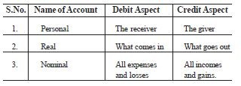
Golden Rules of Accounting

Slide 84
Accounting Equation- Modern Approach

Slide 85
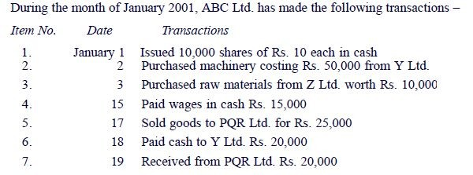
Illustration

Slide 86
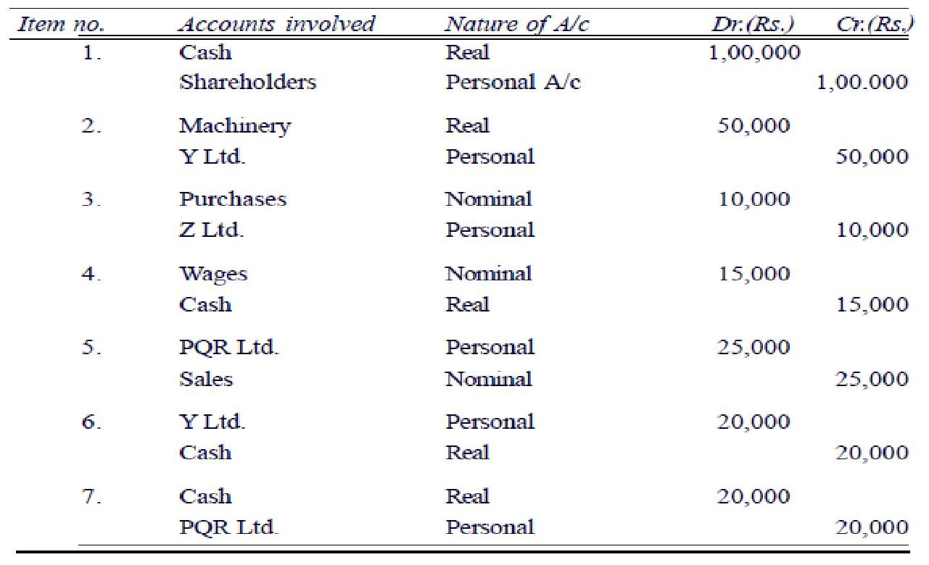
Solution

Slide 87
Journals
The book in which the transaction is recorded for the first time is called journal or book of original entry.
Journal is derived from French word “Jour” which means a day. Journal, therefore, means a daily record of business transactions.
Journal is one of the books of original entry in which transactions are originally recorded in a chronological (day-to-day) order according to the principles of Double Entry System.

Slide 88
Characteristics of Journal
Journal is the first successful step of the double entry system. A transaction is recorded first of all in the journal. So the journal is called the book of original entry.
A transaction is recorded on the same day it takes place. So, journal is called Day Book.
Transactions are recorded chronologically, So, journal is called chronological book
For each transaction the names of the two concerned accounts indicating which is debited and which is credited, are clearly written in two consecutive lines. This makes ledger-posting easy. That is why journal is called "Assistant to Ledger" or "subsidiary book"
Narration is written below each entry.
The amount is written in the last two columns - debit amount in debit column and credit amount in credit column.

Slide 89
Format of Journal
Date (1) | Particulars (2) | L.F (3) | Amount (Dr.) (4) | Amount (Cr.) (5)
DD/MM | Account to be debited .............................Dr. To Account to be credited (Narration) |  | XXX | XXX

Slide 90
Explanation on Format of Journal
1. Date : In the first column, the date of the transaction is entered. The sequence of the dates and months should be strictly maintained.
2. Particulars : Each transaction affects two accounts, out of which one account is debited and the other account is credited.
The name of the account to be debited is written first, very near to the line of particulars column and the word Dr. is also written at the end of the particulars column.
In the second line, the name of the account to be credited is written, starts with the word ‘To’, a few space away from the margin in the particulars column to the make it distinct from the debit account.

Slide 91
Explanation on Format of Journal
3. Narration : After each entry, a brief explanation of the transaction together with necessary details is given in the particulars column with in brackets called narration. The words ‘For’ or ‘Being' are used before starting to write down narration. Now, it is not necessary to use the word ‘For’ or ‘Being’.
4. Ledger Folio (L.F): All entries from the journal are later posted into the ledger accounts. The page number or folio number of the Ledger, where the posting has been made from the Journal is recorded in the L.F column of the Journal. Till such time, this column remains blank.
5. Debit Amount : In this column, the amount of the account being debited is written.
6. Credit Amount : In this column, the amount of the account being credited is written.

Slide 92
Journalising
The process of analysing the business transactions under the heads of debit and credit and recording them in the Journal is called Journalising.
An entry made in the journal is called a ‘Journal Entry’.

Slide 93
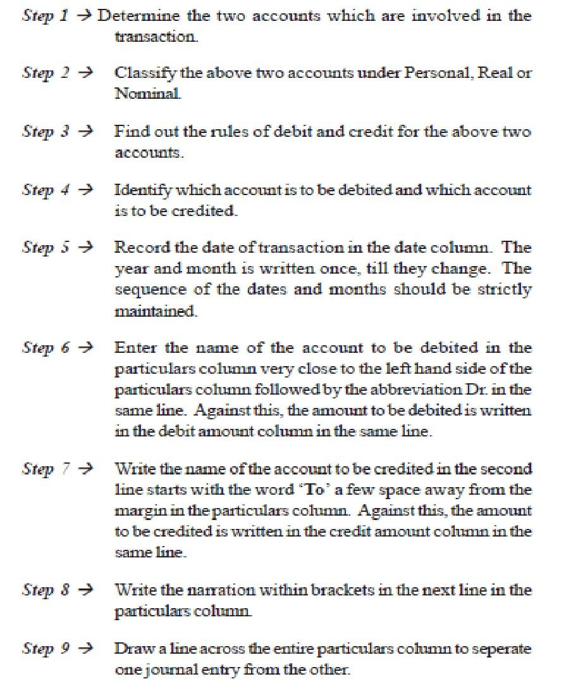
Steps in Journalising

Slide 94
Advantages of Journal
1.
Each transaction is recorded as soon as it takes place. So there is no possibility of any transaction being omitted from the books of account.
Since the transactions are kept recorded in journal, chronologically with narration, it can be easily ascertained when and why a transaction has taken place.
For each and every transaction which of the two concerned accounts will be debited and which account credited, are clearly written in journal.
So, there is no possibility of committing any mistake in writing the ledger.
Since all the debits of transaction are recorded in journal, it is not necessary to repeat them in ledger. As a result ledger is kept tidy and brief.
Journal shows the complete story of a transaction in one entry.
Any mistake in ledger can be easily detected with the help of journal.
2.
3.
4.
5.
6.

Slide 95
Points to be noted while passing journal entries
All business transactions are recorded in the books of the business form the point of view of the business, and not from the point of view of the proprietor.
When the proprietor commences business with loan borrowed from his wife, children or friend, the two
accounts that are required to
taken into and (2)
consideration are (1) cash a/c
Wife’s/Friend’s/Children’s Loan a/c.

Slide 96
Points to be noted while passing journal entries
When a business withdraws cash or goods for personal use (called drawings), it should be debited to drawings a/c and credited to cash/purchase a/c. Eg:- Income tax, chariry, life insurance premium, etc.
When it is not clearly stated in the transaction whether goods are bought for cash or on credit, the purchase should be considered as cash purchase, if the name of the supplier (i.e, seller) of goods is not stated. On the other hand, if the name of the supplier is mentioned, the purchase should be considered as credit purchase and vice versa for sale of good for cash or credit.

Slide 97
Points to be noted while passing journal entries
Purchase or sale of Investment, a/c involved is Investment a/c and not Purchase a/c. The purchase or sale of investment Market value is considered and not the face value.
Brokerage is added for purchase of investment and is deducted when it is sold.

Slide 98
Points to be noted while passing journal entries
Trade discount is an allowance or concession granted by the seller to the buyer, if the customer purchases goods above a certain quantity or above a certain amount. The amount of the purchase made, is always arrived at after deducting the trade discount, ie., only the net amount is considered.
For example, if the list price (price prescribed by the manufacturers or wholesalers) of a commodity is Rs.100, and trade discount granted by manufacturer to the wholesaler is 20% then cost price of the commodity to the wholesaler is Rs.80.
Trade discount is not recorded in the books. They are used for determining the net price.

Slide 99
Points to be noted while passing journal entries
Sale of goods on credit is a common phenomenon in any business. When goods are sold on credit the customers enjoy a facility of making payment on some date in the future. In order to encourage them to make the payment before the expiry of the credit period a deduction is offered. The deduction so made is known as cash discount.
For example, If Ram purchases goods worth Rs.5,000 on 30 days credit then, as per the terms of contract, he is authorised to make payment 30 days after the date of purchase. If he is offered a cash discount of 2% on payment within 10 days and if he does so, he is entitled to deduct Rs.100 from the invoice price and pay Rs.4,900. In this case Rs.100 is cash discount. But if he does not choose to make payment within 10 days then he will not get any cash discount. In this case he will pay Rs.5,000 after 30 days.

Slide 100
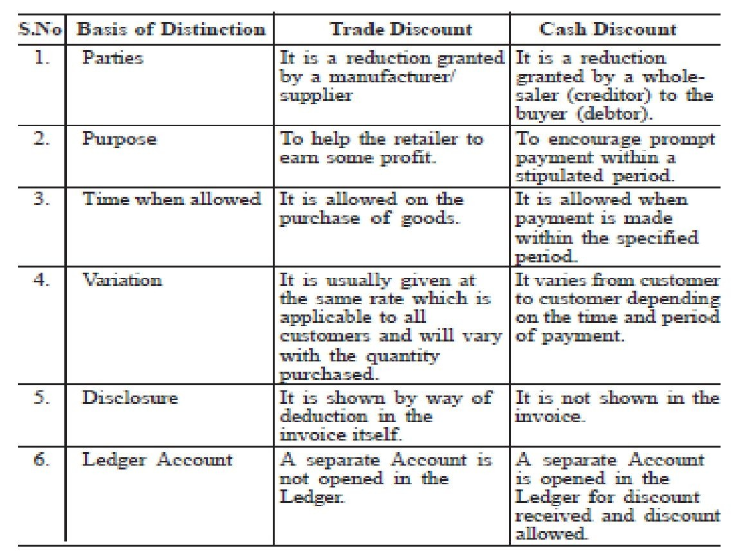
Difference between Trade and Cash Discount

Slide 101
Ledger
The term ‘Ledger’ is derived from the Dutch word ‘Legger’, which means to lie. Therefore , Ledger means a book where the various accounts lie (i.e., are kept).
A ledger account is a summary statement of all the transactions relating to particular person, thing (i.e., an asset) or a service (i.e., an expense or an income) which have taken place during a given period of time, showing their net effect.
According to L.C. Cropper, ‘the book which contains a classified and permanent record of all the transactions of a business is called the Ledger’.

Slide 102
Features of Ledger
Ledger is an account book that contains various accounts to which various business transactions of a business enterprise are posted.
It is an analytical record of transactions.
It is a derived or secondary record.
It is a book of final entry.
It is the principle book of accounts. It is rightly called the king of books of accounts.
It is a permanent record of transactions.
It is the ‘reference book of accounting system

Slide 103
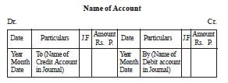
Format of Ledger

Slide 104
Explanation on format of Ledger
Each ledger account is divided into two parts. The left hand side is known as the debit side (Dr.) and the right hand side is known as the credit side (Cr.).
The name of the account is mentioned in the top (middle) of the account.
The date of the transaction is recorded in the date column.
The word ‘To’ is used before the accounts which appear on the debit side of an account in the particulars column. Similarly, the word ‘By’ is used before the accounts which appear on the credit side of an account in the particulars column.

Slide 105
Explanation on format of Ledger
The name of the other account which is affected by the transaction is written either in the debit side or credit side in the particulars column.
The page number of the Journal or Subsidiary Book from where that particular entry is transferred, is entered in the Journal Folio (J.F) column.
The amount pertaining to this account is entered in the amount column.

Slide 106
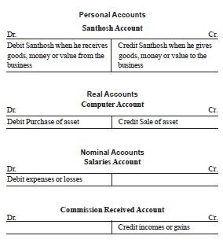
Examples

Slide 107
Importance of Ledger
Knowledge of Business results
Knowledge of book value of assets
Useful for management
Knowledge of Financial Position
Instant Information
Arithmetical Accuracy

Slide 108
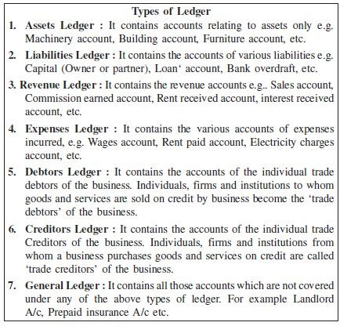
Types of Ledger

Slide 109
Posting
The process of transferring the entries recorded in the journal or subsidiary books to the respective accounts opened in the ledger is called Posting.
In other words, posting means grouping of all the transactions relating to a particular account at one place.
It is necessary to post all the journal entries into various accounts in the ledger because posting helps us to know the net effect of various transactions during a given period on a particular account.

Slide 110
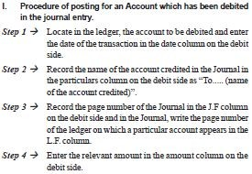
Procedure of posting

Slide 111
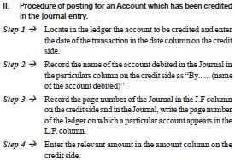
Procedure of posting

Slide 112
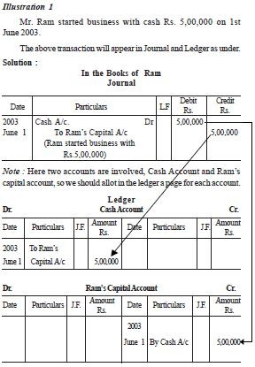

Slide 113
Difference Between Journal and Ledger
Basis of Distinction Journal Ledger
Nature of Book Book of original or prime entry.
Basis for Preparation Source Documents.
Stage of Recording First.
Book of final or secondary entry.
Journal.
Second.
4) Objective of Preparation
To record all transactions in chronological order.
To know the net effect of various transactions affecting a particular account.
5) Format
5 columns: date, particulars, L.F., Dr. amount and Cr. Amount.
Identical 4 Columns on Dr. and Cr. Side: Date, Particulars, folio and amount.
6) Narration
Yes.
No.
7) Process of recording entries
Journalising
Posting
8) Tax authorities
Do not rely upon these Books
Rely on the ledger for assessment purpose.

Slide 114
Balancing an Account
Balance is the difference between the total debits and the total credits of an account.
Balancing means the writing of the difference between the amount columns of the two sides in the lighter (smaller total) side, so that the grand totals of the two sides become equal.

Slide 115
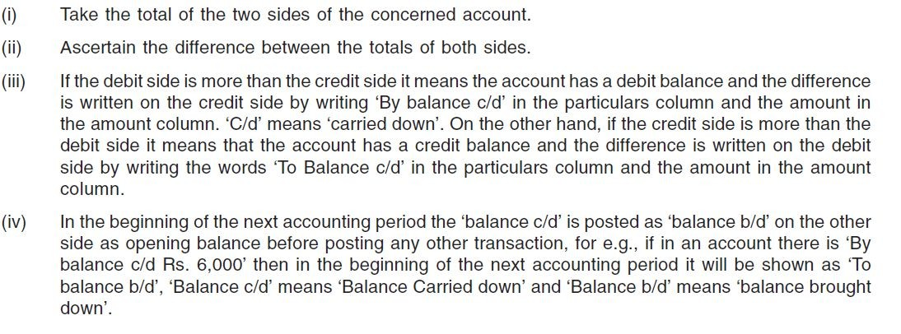
Procedure for Balancing

Slide 116
Trial Balance
Trial balance is a statement which shows debit balances and credit balances of all accounts in the ledger.
“Trial balance is a statement, prepared with the debit and credit balances of ledger accounts to test the arithmetical accuracy of the books” – J.R. Batliboi.

Slide 117
Objectives
The objectives of preparing a trial balance are:
To check the arithmetical accuracy of the ledger accounts.
To locate the errors.
To facilitate the preparation of final accounts.

Slide 118
Advantages
It helps to ascertain the arithmetical accuracy of the book-keeping work done during the period.
It supplies in one place ready reference of all the balances of the ledger accounts.
If any error is found out by preparing a trial balance, the same can be rectified before preparing final accounts.
It is the basis on which final accounts are prepared.

Slide 119
Methods
The Total Method : According to this method, the total amount of the debit side of the ledger accounts and the total amount of the credit side of the ledger accounts are recorded.
The Balance Method : In this method, only the balances of an account either debit or credit, as the case may be, are recorded against their respective accounts.

Slide 120
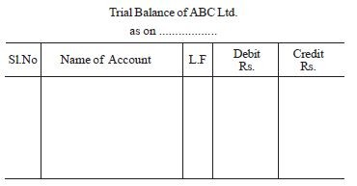
Format

Slide 121
Important Points to be noted while preparing
Trial Balance
Only those ledger accounts which show balances should appear in trial balance.
If the Ledger a/c shows a Dr. balance, it should appear on Dr. side of the trial balance and vice versa.
The nature of the balances of the various ledger a/c’s and their treatment are as follows

Slide 122
Important Points to be noted while preparing Trial Balance
 | Ledger A/c | Type of Balance (Dr. Balance or Cr. Balance) | Treatment in Trial Balance (Dr. side or Cr. Side)
 | Capital | Cr. | Cr.
 | Drawings | Dr. | Dr.
 | Sundry Debtors | Dr. | Dr.
 | Sundry Creditors | Cr. | Cr.
 | Cash at Bank | Dr. | Dr.
 | Bank Overdraft | Cr. | Cr.
 | Cash in Hand | Dr. | Dr.
 | Purchases | Dr. | Dr.
 | Purchase Returns | Cr. | Cr.
 | Sales | Cr. | Cr.
 | Sales Returns | Dr. | Dr.
 | Opening Stock | Dr. | Dr.
 | Accounts of Fixed Assets | Dr. | Dr.
 | Accounts of Expenses & Losses | Dr. | Dr.
 | Accounts of Incomes and Gains | Cr. | Cr.

Slide 123
Errors in Accounting
The tallying of the two totals (debit balances and credit balances) of the trial balance ensures only arithmetic accuracy but not accounting accuracy.
If however, the two totals do not tally, it implies that some errors have been committed while recording the transactions in the books of accounts.

Slide 124
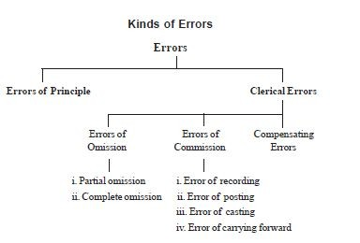
Kinds of Errors

Slide 125
Errors of Principle
Transactions are recorded as per generally accepted accounting principles. If any of these principles is violated or ignored, errors resulting from such violation are known as errors of principle.
For example, Purchase of assets recorded in the purchases book.

Slide 126
Clerical Errors
These errors arise because of mistakes committed in the ordinary course of accounting work.
These can be further classified into three types as follows.
a) Errors of Omission
This error arises when a transaction is completely or partially omitted to be recorded in the books of accounts.

Slide 127
Clerical Errors
i. Error of Complete Omission: This error arises when a transaction is totally omitted to be recorded in the books of accounts.
For example, Goods purchased from Ram completely omitted to be recorded.
This error does not affect the trial balance.

Slide 128
Clerical Errors
ii. Error of Partial Omission: This error arises when only one aspect of the transaction either debit or credit is recorded.
For example, a credit sale of goods to Siva recorded in sales book but omitted to be posted in Siva’s account.
This error affects the trial balance.

Slide 129
Clerical Errors
b) Errors of Commission
This error arises due to wrong recording, wrong posting, wrong casting, wrong balancing, wrong carrying forward etc. Errors of commission may be classified as follows:
i. Error of Recording: This error arises when a transaction is wrongly recorded in the books of original entry.
For example, Goods of Rs.5,000, purchased on credit from Viji, is recorded in the book for Rs.5,500.
This error does not affect the trial balance.

Slide 130
Clerical Errors
ii. Error of Posting: This error arises when information recorded in the books of original entry are wrongly entered in the ledger.
Error of posting may be
1.
2.
3.
4.
5.
6.
Right amount in the right side of wrong account. Right amount in the wrong side of correct account Wrong amount in the right side of correct account Wrong amount in the wrong side of correct account Wrong amount in the wrong side of wrong account Wrong amount in the right side of wrong account, etc.
This error may or may not affect the trial balance.

Slide 131
Clerical Errors
iii. Error of Casting (Totalling) : This error arises when a mistake is committed while totalling the subsidiary book.
For example, instead of Rs.12,000 it may be wrongly totalled as Rs.13,000. This is called overcasting. If it is wrongly totalled as Rs.11,000, it is called undercasting.

Slide 132
Clerical Errors
iv. Error of Carrying Forward : This error arises when a mistake is committed in carrying forward a total of one page to the next page.
For example, Total of purchase book in page 282 of the ledger Rs.10,686, while carrying forward the balance to the next page it was recorded as Rs.10,866.

Slide 133
Clerical Errors
c) Compensating Errors
The errors arising from excess debits or under debits of accounts being neutralised by the excess credits or under credits to the same extent of some other account is compensating error.
For example, If the purchases book and sales book are both overcast (excess totalling) by Rs.10,000, the errors mutually compensate each other.

Slide 134
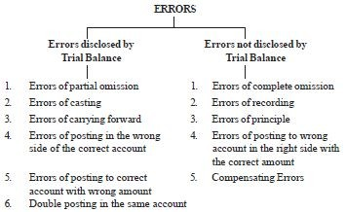
Errors disclosed and not disclosed by
trial balance

Slide 135
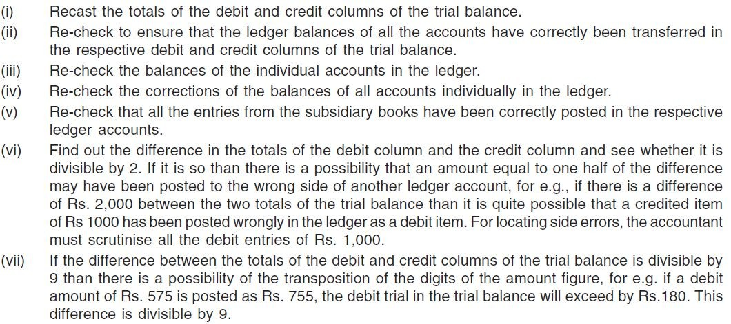
Location of Errors

Slide 136
Suspense Account
When it is difficult to locate the mistakes before preparing the final accounts, the difference in the trial balance is transferred to newly opened imaginary and temporary account called ‘Suspense Account’.
If the total debit balances of the trial balance exceeds the total credit balances, the difference is transferred to the credit side of the suspense account.
On the other hand, if the total credit balances of the trial balance exceeds the total debit balances the difference is transferred to the debit side of the suspense account.

Slide 137
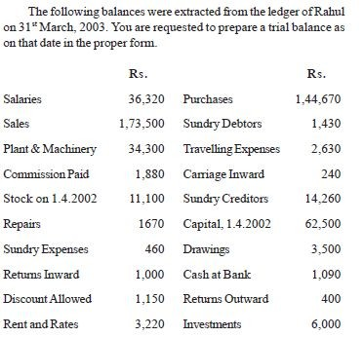
Illustration 1

Slide 138
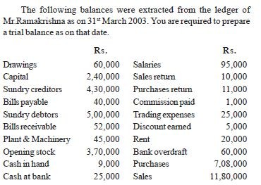
Illustration 2

